Slide 1

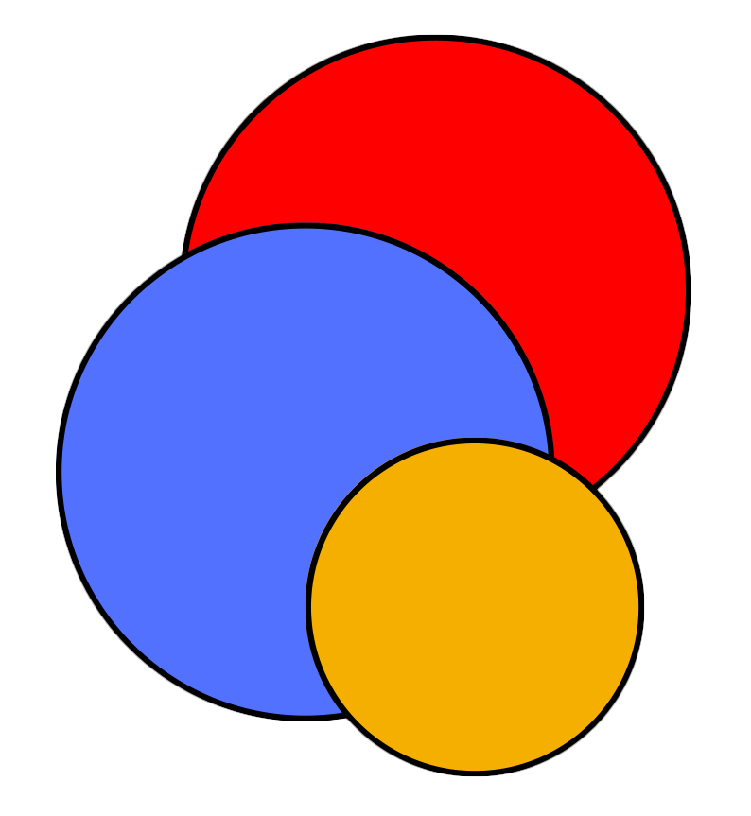
CIS
Lab
October 17
2023 INFORMS Annual Meeting
Balancing Accuracy and Computing Costs: Are Decomposition Methods Still Needed in the Era of Optimization Frameworks?
P. Bunnak¹, S. Coniglio², S. Galelli¹
¹ Cornell University
² University of Bergamo

Slide 2
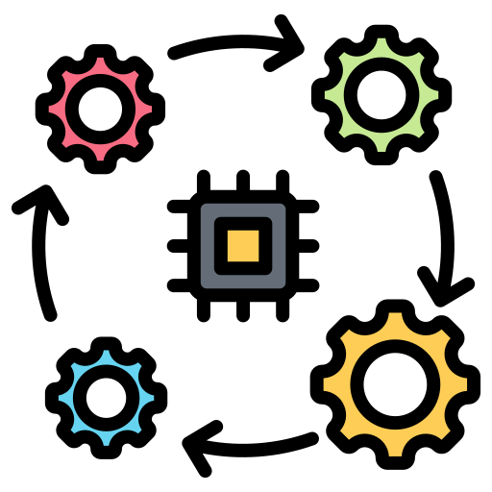



Energy / power system analysis
Common challenges
Representation of interactions with other socio-economic sectors
Analyses across large(r) spatio-temporal domains
Integration of weather and climate uncertainty
Increase in computational requirements

Slide 3
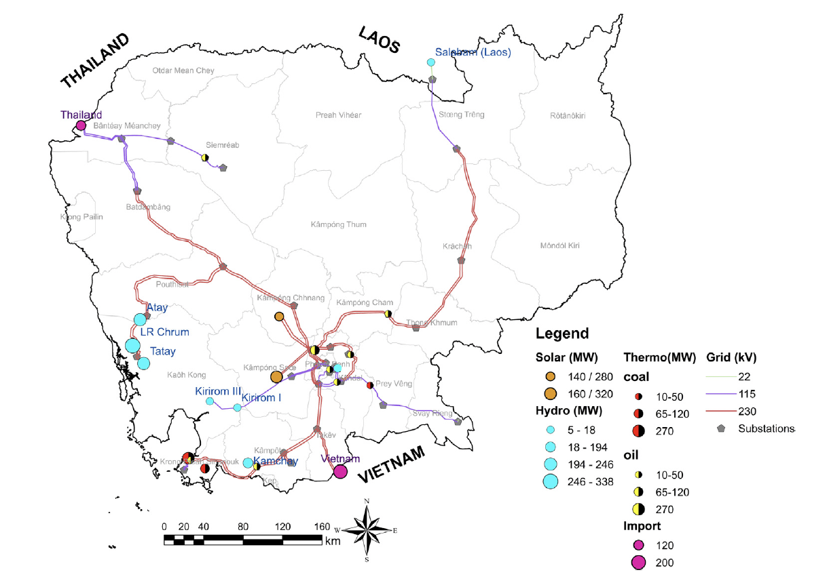
Increase in computational requirements
Example
Cambodian power system
Installed capacity ~ 2 GW
Hydropower capacity ~ 1 GW
Koh et al. (2022), Applied Energy, 321, 119386

Slide 4
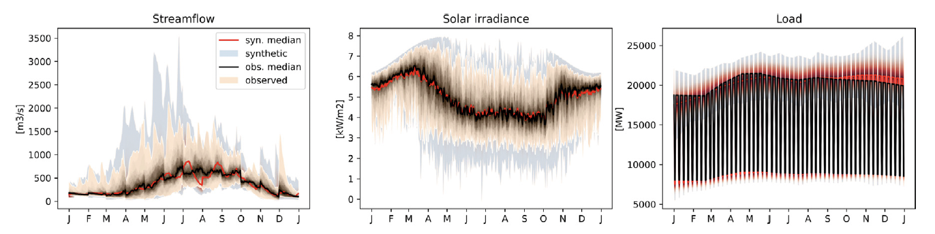
Increase in computational requirements
Example
1000-year synthetic dataset of daily streamflow, solar irradiance and load
Koh et al. (2022), Applied Energy, 321, 119386
Notes:
- Kirsch–Nowak Streamflow Generator

Slide 5
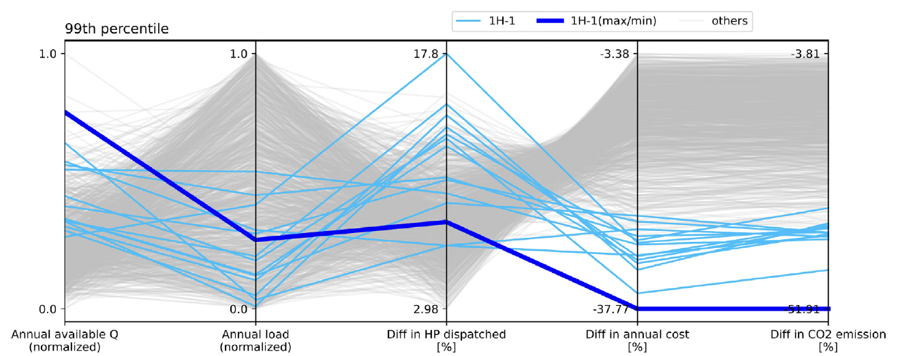
Increase in computational requirements
Example
System’s response (evaluated via simulation)
Run time ~ 7,900 sec
Koh et al. (2022), Applied Energy, 321, 119386
Notes:
- 0.0215 s

Slide 6

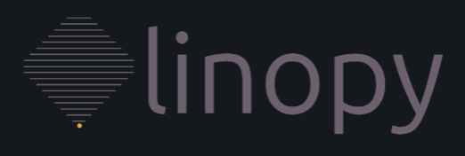
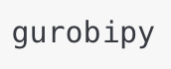

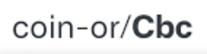


Balancing Accuracy and Computing Costs
Strategies
Rely on faster optimization frameworks
Better connection between data analysis packages (e.g., xarray and pandas) with solvers
Algebraic (opt.) modeling languages
Time-to-build
Solver
Time-to-solve

Slide 7
Balancing Accuracy and Computing Costs
Strategies
Rely on faster optimization frameworks
Adopt simplifications of temporal, spatial, or technological dimensions
Reduce the number of weather events
Aggregate the representation of power fleet components into macro areas
Generator
Smaller uncertainty set
Less decision variables
Sub-station

Slide 8
Balancing Accuracy and Computing Costs
Strategies
Rely on faster optimization frameworks
Adopt simplifications of temporal, spatial, or technological dimensions
Reduce the number of weather events
Aggregate the representation of power fleet components into macro areas
Generator
Smaller uncertainty set
Less decision variables
Sub-station

Slide 9
Balancing Accuracy and Computing Costs
Strategies
Rely on faster optimization frameworks
Adopt simplifications of temporal, spatial, or technological dimensions
→ structural uncertainty
Reduce the number of weather events
Aggregate the representation of power fleet components into macro areas
Drop the representation of unit commitment
Smaller uncertainty set
Less decision variables
Simpler formulation (MILP → LP, MINLP → NLP)

Slide 10
Balancing Accuracy and Computing Costs
Strategies
Accuracy
Rely on faster optimization frameworks
Adopt simplifications of temporal, spatial, or technological dimensions
Build on decomposition methods
Computing costs
(time-to-solve)

Slide 11
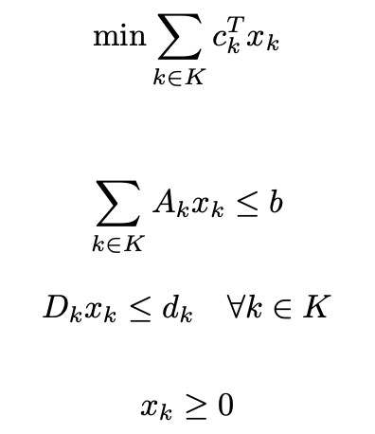
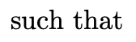
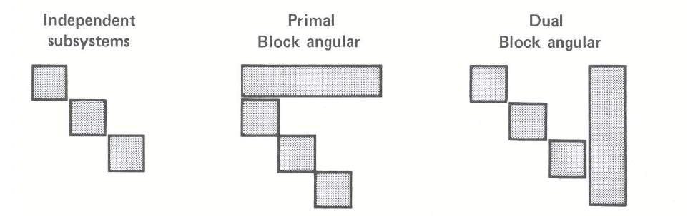
Decomposition methods
Structural forms of large-scale problems
Visualization of the A matrix
Coupling constraints
Coupling variables
Nearly independent subsystems
Constraint
Variable
Source: Bradley et al. (1977), Applied Mathematical Programming.

Slide 12
Decomposition methods
Structural forms of large-scale problems
Visualization of the A matrix
Coupling constraints
Subproblems
Constraint
Variable
Source: Bradley et al. (1977), Applied Mathematical Programming.
Notes:
- Decomposition vs column generation?

Slide 13
Decomposition methods
Advantages
Preserve the original problem formulation / delay decisions on its simplification
Reduce computing costs
Allow for parallel computation
Accuracy
Computing costs
(time-to-build)

Slide 14
Generation technology
PowNet
Other parameters
Dispatchable wind
and solar
Hourly electricity demand
Techno-economic parameters of thermoelectric units
Transmission capacity
Dispatchable hydropower
PowNet
(MILP problem: minimize production cost, meet demand)
Generation mix, power flow
+
Costs, CO₂ emissions
Chowdhury et al. (2020), Journal of Open Research Software, 8(1)
https://github.com/Critical-Infrastructure-Systems-Lab

Slide 15
PowNet + Dantzig-Wolfe decomposition
Master problem
Flow balance
Reserve requirement
Renewable/Import bound
Transmission
Min/Max line capacity
Voltage angle
Reference node
‘Self-scheduling’ sub-problems
Minimum-down
Minimum-up time
Ramp down
Ramp up
MIP tightening constraints
Strengthened minimum-down time
Strengthened minimum-up time
Trajectory down
Trajectory up
Relationship between variables
Dispatch linkage
Status linkage

Slide 16
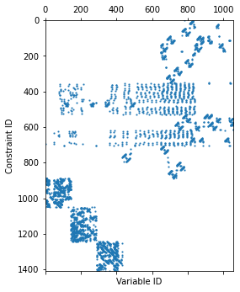
PowNet + Dantzig-Wolfe decomposition
Example – ‘dummy’ power system
Visualization of the A matrix
pGas
pOil
lineCap
1762 MW
lineCap
200 MW
Node 3
Buyer
MaxDemand
32 MW
pBiomass
lineCap
300 MW
lineCap
1762 MW
lineCap
300 MW
Node1
MaxDemand
700 MW
node2
MaxDemand
102 MW
lineCap
80 MW
lineCap
100 MW
pHydro
Max = 36 MW
lineCap
80 MW
Supplier
Max 60 MW

Slide 17
Experimental setup
Formulation based on Knueven et al. (2020)
Implementation in Gurobipy + Gurobi
PowNet 2.0 vs PowNet 2.0 + DW
Experiments carried out on Hopper Cluster (@Cornell CAC)
Dual 20-core Intel Xeon Gold 5218R CPUs @ 2.1 GHz, 192 GB of RAM
OpenHPC 2.3 with Rocky Linux 8.4
Gurobi 9.5.1
Modeling instances (24 hours)
‘Dummy’ power system (1,411 constraints and 1,056 variables)
Cambodia (8,364 constraints and 5,952 variables)
Thailand (74,633 constraints and 54,312 variables)
PowNet 2.0
Knueven et al. (2020), INFORMS Journal on Computing, 32(4)

Slide 18
Preliminary results
‘Dummy’ power system (3 Blocks)
pGas
pOil
lineCap
1762 MW
lineCap
200 MW
 | PowNet | PowNet+DW
Obj. f. | 1,612,145 | 1,629,253
Time-to-solve, TOT (sec) | 0.0084 | 0.4692
Time-to-solve, Master problem (sec) | - | 0.0976
Time-to-solve, Sub-problems (sec) | - | 0.3716
Node 3
Buyer
MaxDemand
32 MW
pBiomass
lineCap
300 MW
lineCap
1762 MW
lineCap
300 MW
Node1
MaxDemand
700 MW
node2
MaxDemand
102 MW
lineCap
80 MW
lineCap
100 MW
pHydro
Max = 36 MW
lineCap
80 MW
Supplier
Max 60 MW

Slide 19
Preliminary results
‘Dummy’ power system (3 Blocks)
Visualization of the A matrix
 | PowNet | PowNet+DW
Obj. f. | 1,612,145 | 1,629,253
Time-to-solve, TOT (sec) | 0.0084 | 0.4692
Time-to-solve, Master problem (sec) | - | 0.0976
Time-to-solve, Sub-problems (sec) | - | 0.3716
Optimality gap:
1.06%

Slide 20
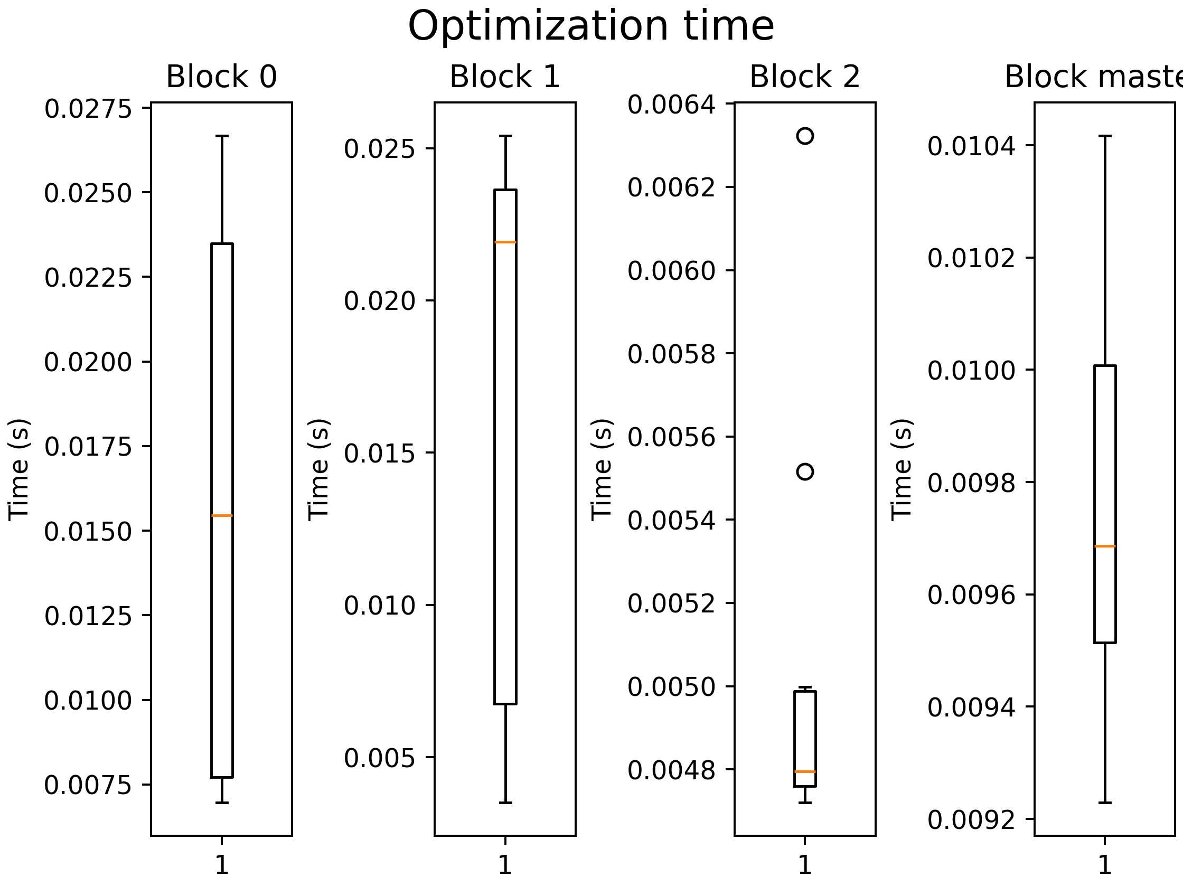
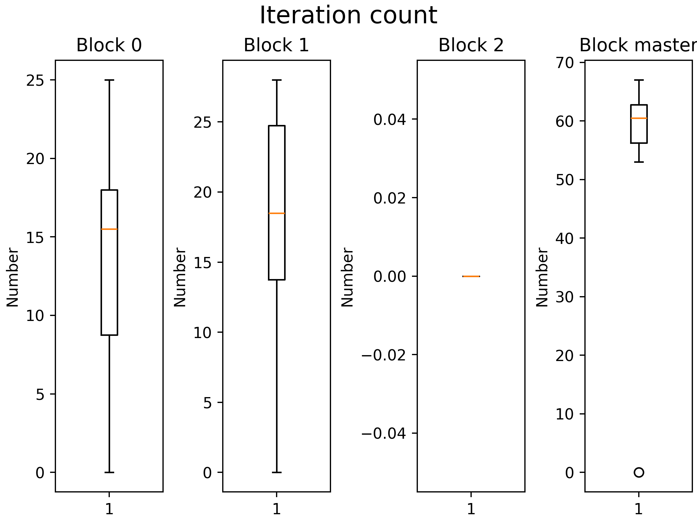
Preliminary results
‘Dummy’ power system (3 Blocks)
 | PowNet | PowNet+DW
Obj. f. | 1,612,145 | 1,629,253
Time-to-solve, TOT (sec) | 0.0084 | 0.4692
Time-to-solve, Master problem (sec) | - | 0.0976
Time-to-solve, Sub-problems (sec) | - | 0.3716
Optimality gap:
1.06%

Slide 21
Preliminary results
Cambodia’s grid (18 Blocks)
 | PowNet | PowNet+DW
Obj. f. | 438,281 | 451,075
Time-to-solve, TOT (sec) | 0.0215 | 0.6643
Time-to-solve, Master problem (sec) | - | 0.0943
Time-to-solve, Sub-problems (sec) | - | 0.5700

Slide 22
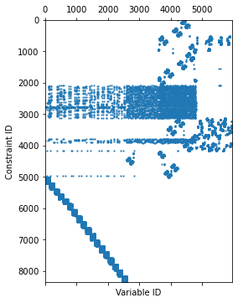
Preliminary results
Cambodia’s grid (18 Blocks)
Visualization of the A matrix
 | PowNet | PowNet+DW
Obj. f. | 438,281 | 451,075
Time-to-solve, TOT (sec) | 0.0215 | 0.6643
Time-to-solve, Master problem (sec) | - | 0.0943
Time-to-solve, Sub-problems (sec) | - | 0.5700
Optimality gap:
% 2.92

Slide 23
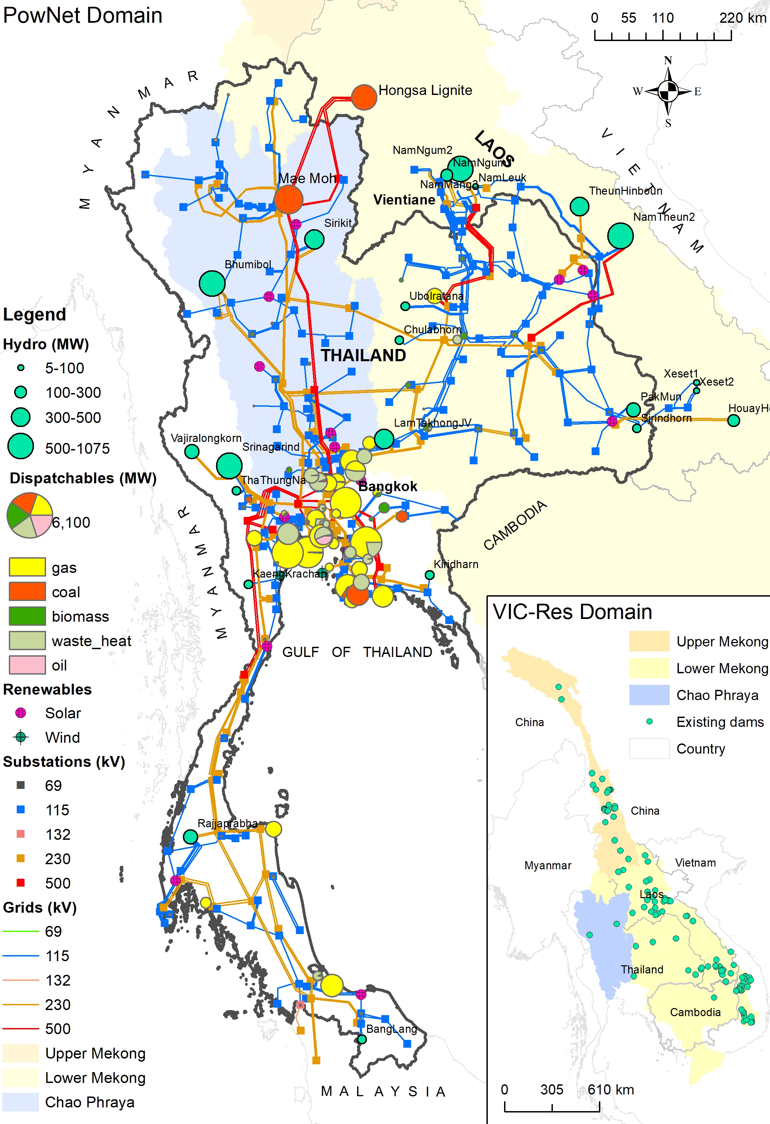
Preliminary results
Thai grid (151 Blocks)
 | PowNet | PowNet+DW
Obj. f. | 36,888,014 | 38,763,317
Time-to-solve, TOT (sec) | 13.3008 | 19.8815
Time-to-solve, Master problem (sec) | - | 12.1936
Time-to-solve, Sub-problems (sec) | - | 7.6879

Slide 24
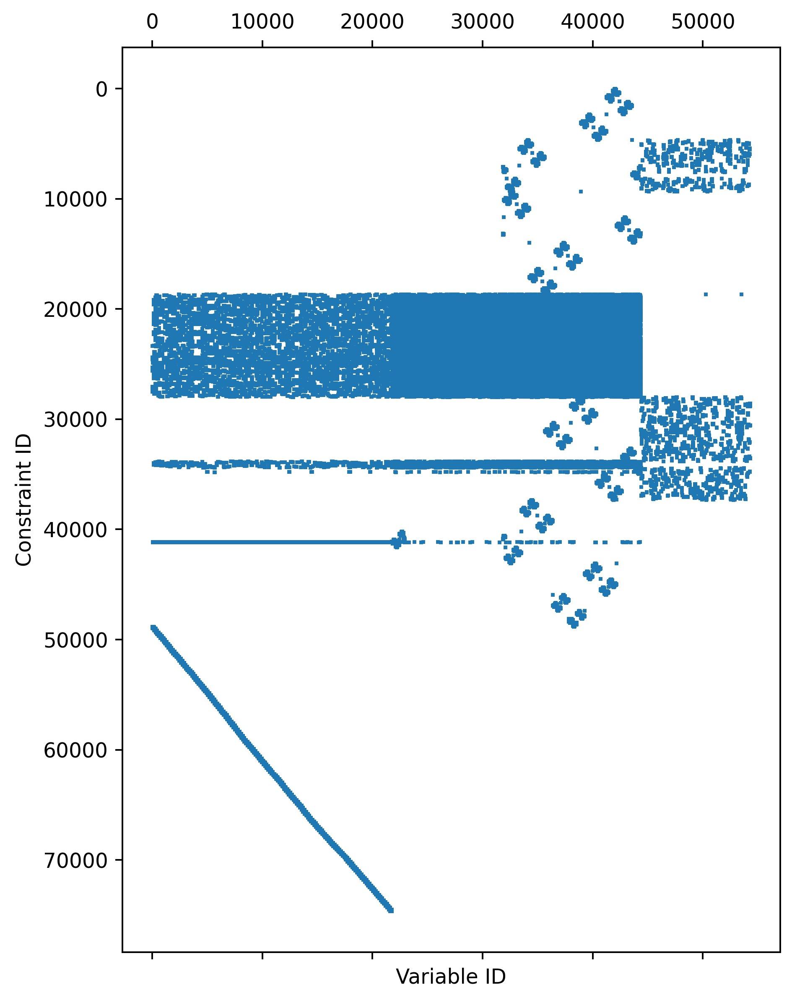
Preliminary results
Thai grid (151 Blocks)
Visualization of the A matrix
 | PowNet | PowNet+DW
Obj. f. | 36,888,014 | 38,763,317
Time-to-solve, TOT (sec) | 13.3008 | 19.8815
Time-to-solve, Master problem (sec) | - | 12.1936
Time-to-solve, Sub-problems (sec) | - | 7.6879
Optimality gap:
% 5.08
Potential for parallelization

Slide 25
Conclusions
Implementation of DW decomposition for a large-scale power system model
Computing costs
PowNet
PowNet + DW
# decision variables

Slide 26
Conclusions
Implementation of DW decomposition for a large-scale power system model
Major improvements expected with
Parallelization schemes
Computing costs
PowNet
PowNet + DW
PowNet + DW + Parallel.
# decision variables

Slide 27
Conclusions
ASEAN Power Grid
Implementation of DW decomposition for a large-scale power system model
Major improvements expected with
Parallelization schemes
Larger grids

Slide 28
Conclusions
ASEAN Power Grid
Implementation of DW decomposition for a large-scale power system model
Major improvements expected with
Parallelization schemes
Larger grids
PowNet 2.0 + DW implementation to be released on GitHub PowNet’s webpage

Slide 29

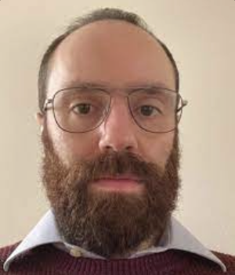
Acknowledgments
Phumthep Bunnak
Stefano Coniglio

Slide 30






CIS
Lab
Thank you!
galelli@cornell.edu
https://galelli.cee.cornell.edu
@GalelliStefano

